Slide 1
GALENA TERRITORIES AND APPLE CANYON MEETING
AUGUST 6th, 2024

Slide 2
AGENDA
Introductions/Values
Regulations
Water Quality Reports
Billing/Payment Processing
Interpreting Bills
Source Water Assessments and Future Projects

Slide 3
PERSONNEL AND VALUES
Personnel
Justin Kersey – President
Mike Miller – Vice President of Operations
Steve Winter – Operations Manager
Tanya Peters – Administrative Support
Andrew Dickson – Finance Manger
David Hankins – Safety & Compliance
Prairie Path Water Company
Nexus/PPWC Values driving Operational Excellence
Safety First
Customer Care
Employee Success
Environmental Stewardship

Slide 4
REGULATIONS
Illinois Commerce Commission (ICC):
Commissioners are appointed by Governor
ICC determines rates, rules and regulations
Enforce certain preventative standards (e.g meter testing)
Environmental Protection Agency (EPA):
Federal and State agencies
Enforce treatment standards, sampling requirements and required monthly and annual reporting
Required BWO if distribution pressure drops below 20 psi
Get the Lead Out initiative
Internal (HSE):
Required Preventative Maintenance measures
Bi-annual flushing, asset inspections and condition assessments for Asset Management Program

Slide 5
SERVICE LINE INSPECTIONS
Get the lead out initiative
EPA initiative (federal government)
Lead is toxic to humans, especially when it contaminates drinking water. While lead has been virtually eliminated from public utility water systems, it can still be found in older home plumbing. The U.S. EPA has declared the elimination of lead in drinking water a national health priority, with a key focus being Lead Service Lines — the pipes that connect homes and businesses to public watermains.
Ways to identify
Completing survey on company website with clear photos of service line attached
Operations may still reach out if clear photos aren’t attached to schedule a time to inspect service line
Schedule time with operations to come in your home and have them identify service line. (this should only take about 5 minutes)
Current statistics
118 of 960 homes left to identify in Apple Canyon
602 of 2233 homes left to identify in Galena
No lead lines found in either system at this time

Slide 6
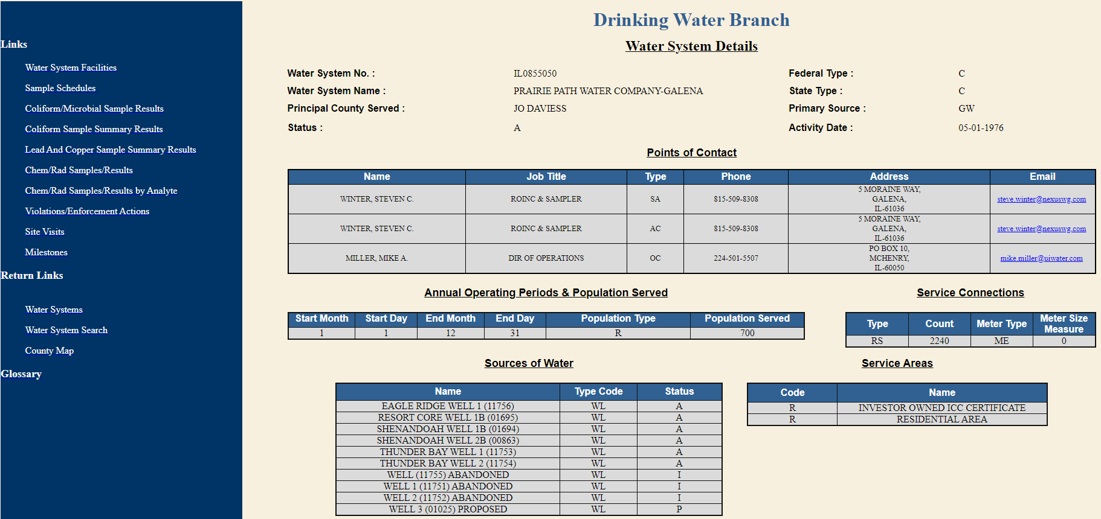

Slide 7
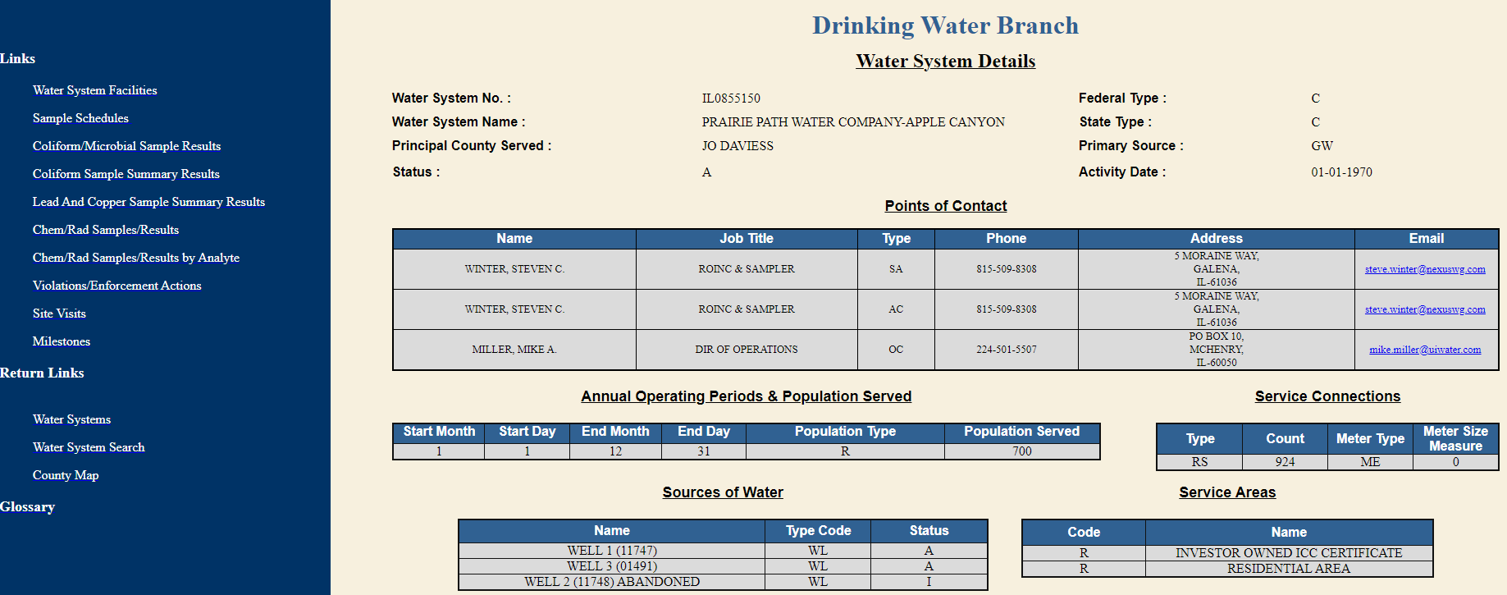

Slide 8
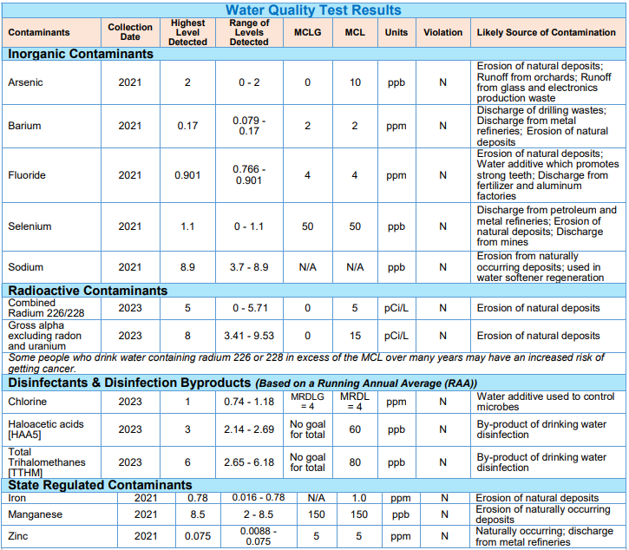
WATER QUALITY
REPORT
- Galena -2023

Slide 9
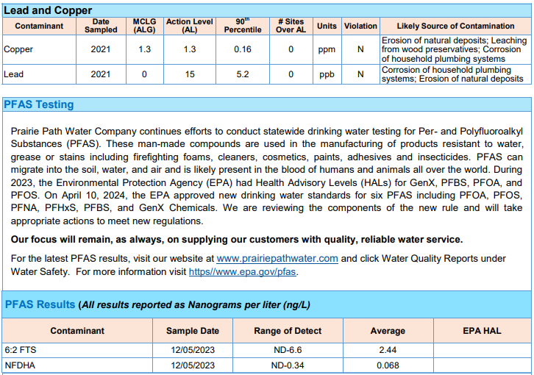
WATER QUALITY
REPORT
- Galena -2023

Slide 10
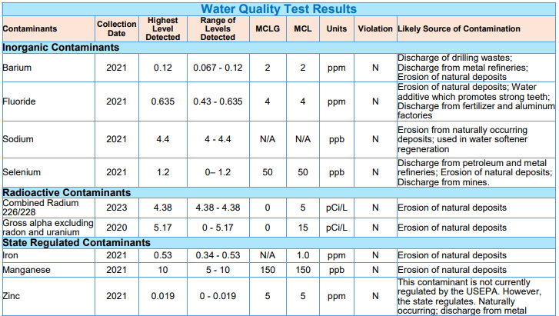
WATER QUALITY
REPORT
- Apple Canyon -2023

Slide 11
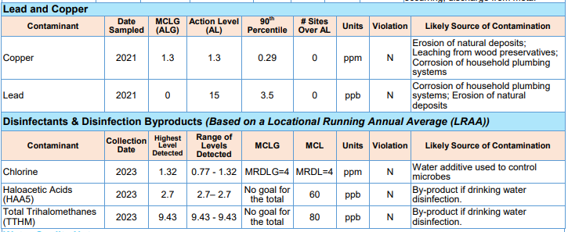
WATER QUALITY
REPORT
- Apple Canyon -2023

Slide 12
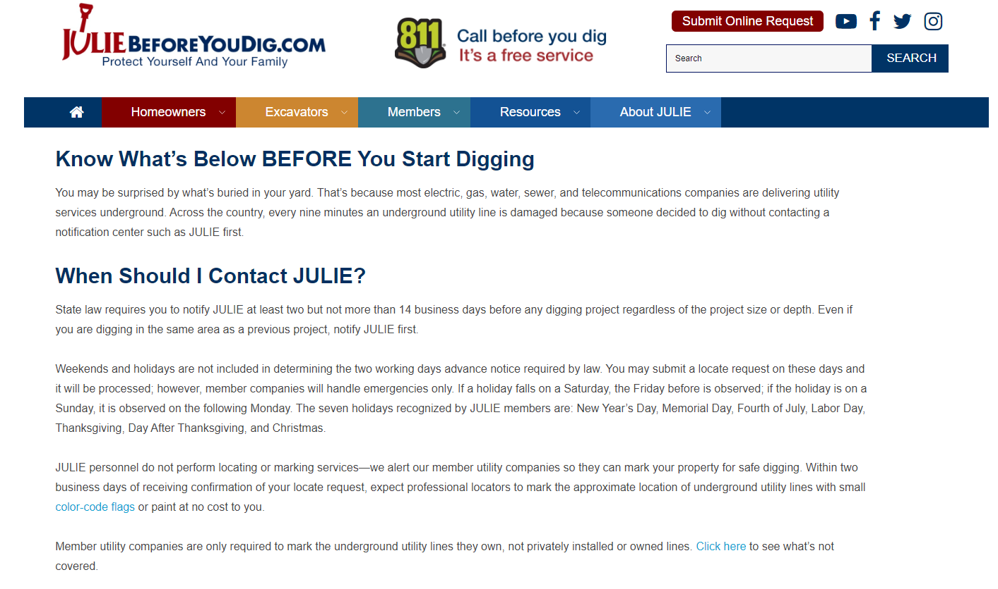
JULIE - CALL BEFORE YOU DIG

Slide 13
BILLING/PAYMENT PROCESSING
Third-party lockbox processor now in Carol Stream, IL
My Utility Account will be helpful in receiving paperless bills and alerts/notifications via email. Manage alert preferences via MUA
Mailers are still mailed even with paperless billing

Slide 14
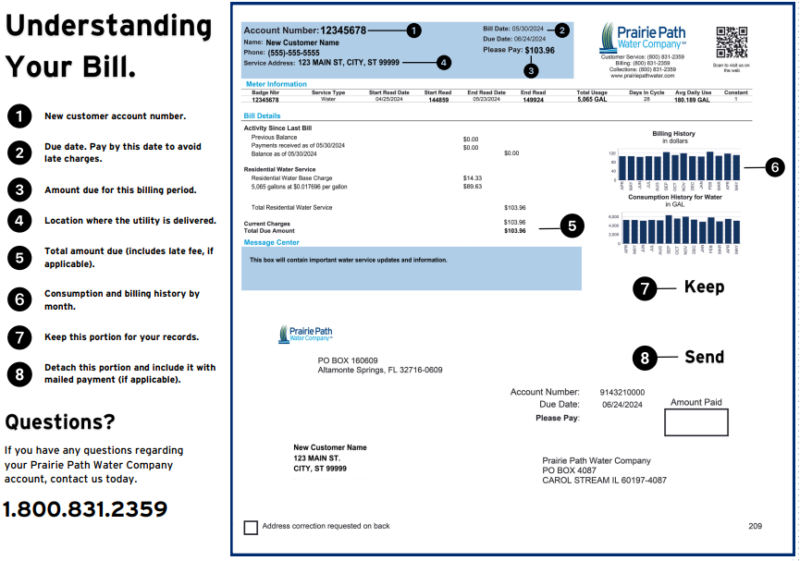

Slide 15
SOURCE WATER ASSESSMENT - GALENA
New Source Water Protection Plans developed in 2024
Prairie Path Water Company is committed to Source Water Protection Programs with the purpose of ensuring the safety, integrity and sustainability of our communities’ drinking water, for current and future generations to come.
All the wells are shallow bedrock wells except Shenandoah Well 1 and Eagle Ridge Resort Core Well 1 which are deep bedrock wells. Eagle Ridge Well 2 has a high susceptibility to surface contamination because it is a shallow bedrock well and is in the A1 rating. Shenandoah Well 2 and Thunder Bay West Well 2 have a low susceptibility to surface contamination even though they are shallow wells because they are in the F rating. Eagle Ridge Resort Core Well 1 has a low susceptibility to surface contamination because it is a deep bedrock well even though it is in the susceptible A1 rating. Shenandoah Well 1 is also a deep bedrock well in addition to being in the F rating so it has a very low susceptibility to surface contamination.

Slide 16
SOURCE WATER ASSESSMENT – APPLE CANYON
New Source Water Protection Plans developed in 2024
Prairie Path Water Company is committed to Source Water Protection Programs with the purpose of ensuring the safety, integrity and sustainability of our communities’ drinking water, for current and future generations to come.
Both of the system’s wells are deep bedrock wells, so they have minimal susceptibility to contamination unlike shallow wells in this rating. The bedrock layers including the Maquoketa Shale, which is near the surface, protect the well intake zone from nearly all possible surface contamination. Therefore, the geologic susceptibility to contamination of groundwater pumped by the wells is considered low.
Sites within the well’s 200- and 1,000-foot setback zones were considered as possible threats to groundwater quality. There were no point source contaminants identified for Wells 1 and 3 within the setback zones of the wells.

Slide 17
FUTURE PROJECTS
Asset Management Program
Review of assets and their condition to determine likelihood of failure and consequence of failure. Then prioritize projects accordingly.
2024
Coordinating with Apple Canyon Lake Association on their spillway project​
Continued review and analysis of district meters to assist with leak detection and reduction of unaccounted for water. ​
Galena system pressure analysis. ​
Service line replacements​
Galena Sanitary sewer CCTV maintenance and rehabilitation of deficiencies
2025
Service line replacements​
Galena Sanitary sewer CCTV maintenance and rehabilitation of deficiencies
Galena WWTP Package Plant #3 Rehab

Slide 18
FUTURE PROJECTS
2026+
Galena Shenandoah Reservoir Cleaning and Rehabilitation​
Galena Resort Core Reservoir Cleaning and Rehabilitation​
Apple Canyon Tank Rehab
Service line replacements​
Galena Sanitary sewer CCTV maintenance and rehabilitation of deficiencies

